Slide 1

SPARK

Slide 2
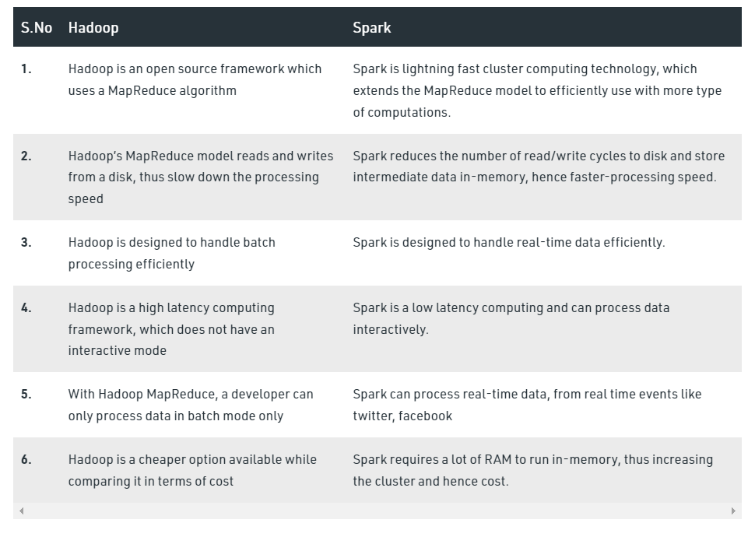

Slide 3
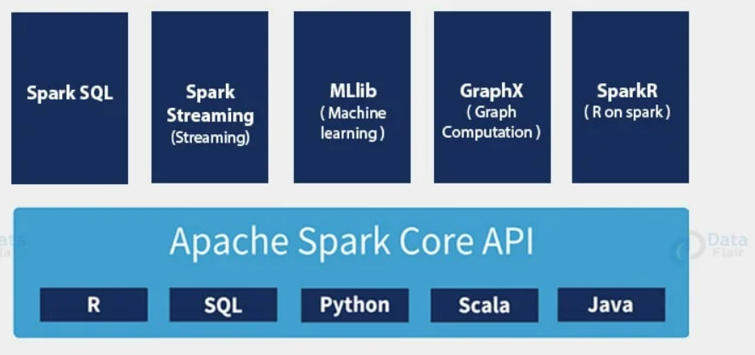

Slide 4


Slide 5
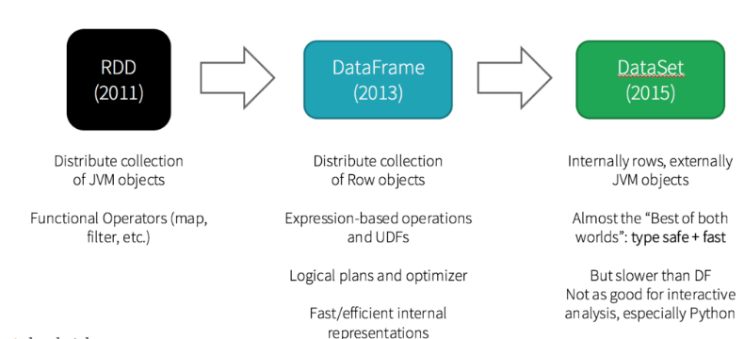
CONTENTS
Introduction to RDDs
Basic RDD operations
Local Vs Cluster mode
Working with Key/Value pairs

Slide 6
What is RDD?
The RDD (Resilient Distributed Dataset) is the Spark's core abstraction.
It is a collection of elements, partitioned across the nodes of the cluster so that we can execute various parallel operations on it.

Slide 7
There are two ways to create RDDs:
Parallelizing an existing data in the driver program
Referencing a dataset in an external storage system, such as a shared filesystem, HDFS, HBase, or any data source offering a Hadoop InputFormat.

Slide 8

Parallelized Collections
To create parallelized collection, call SparkContext's parallelize method on an existing collection in the driver program.
Each element of collection is copied to form a distributed dataset that can be operated on in parallel.
Now, we can operate the distributed dataset (distinfo) parallel such like distinfo.reduce((a, b) => a + b).

Slide 9
External Datasets
In Spark, the distributed datasets can be created from any type of storage sources supported by Hadoop such as HDFS, Cassandra, HBase and even our local file system.
Spark provides the support for text files, SequenceFiles, and other types of Hadoop InputFormat.
SparkContext's textFile method can be used to create RDD's text file.
This method takes a URI for the file (either a local path on the machine or a hdfs://) and reads the data of the file.

Slide 10
Now, we can operate data on by dataset operations such as we can add up the sizes of all the lines using the map and reduceoperations as follows: data.map(s => s.length).reduce((a, b) => a + b).

Slide 11
Basic RDD Operations
The RDD provides the two types of operations:
Transformation
Action

Slide 12
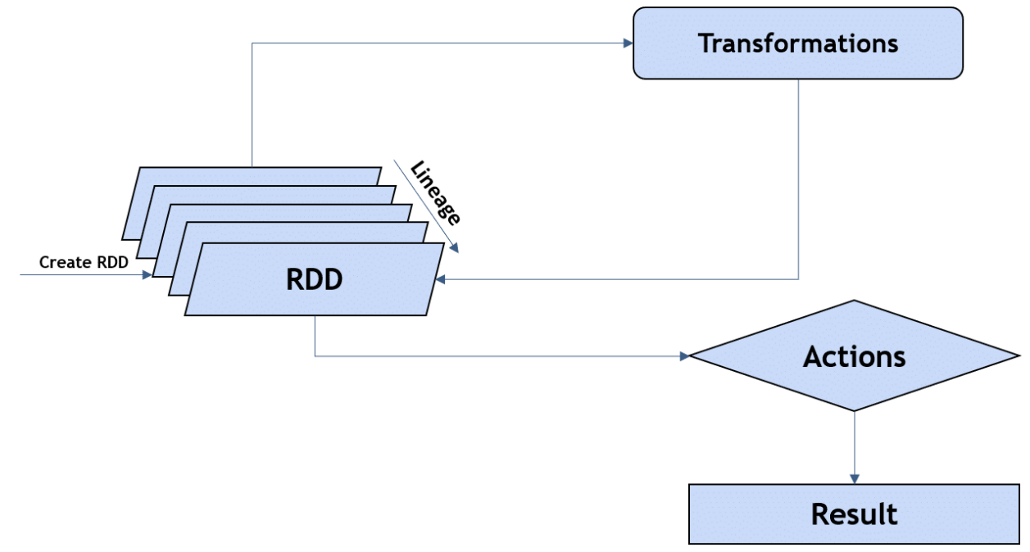

Slide 13
Transformation
In Spark, the role of transformation is to create a new dataset from an existing one.
The transformations are considered lazy as they only computed when an action requires a result to be returned to the driver program.
Let's see some of the frequently used RDD Transformations.

Slide 14
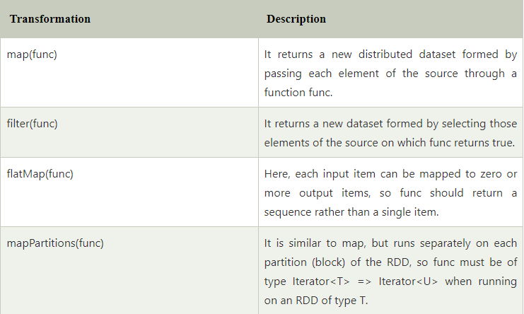

Slide 15
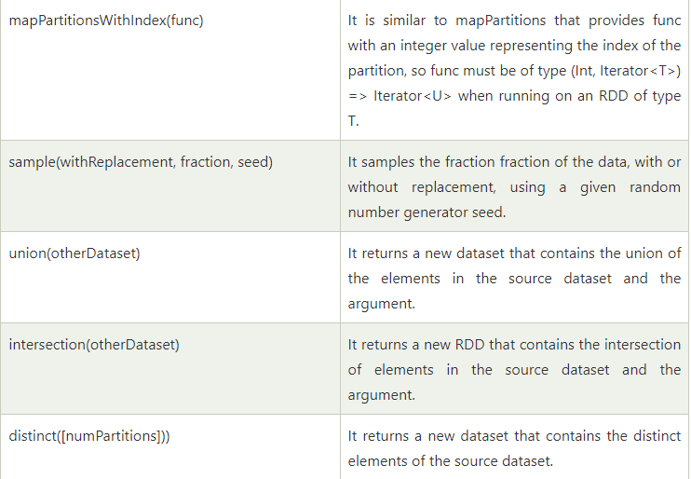

Slide 16
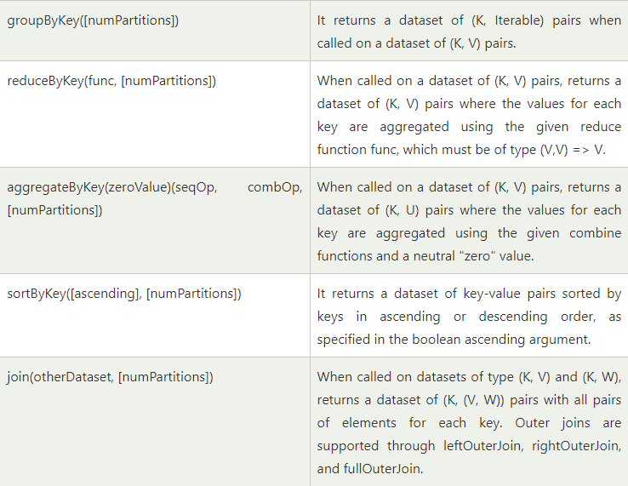

Slide 17
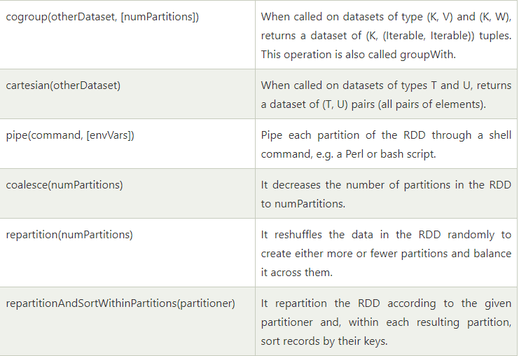

Slide 18
Action
In Spark, the role of action is to return a value to the driver program after running a computation on the dataset.
Let's see some of the frequently used RDD Actions.

Slide 19
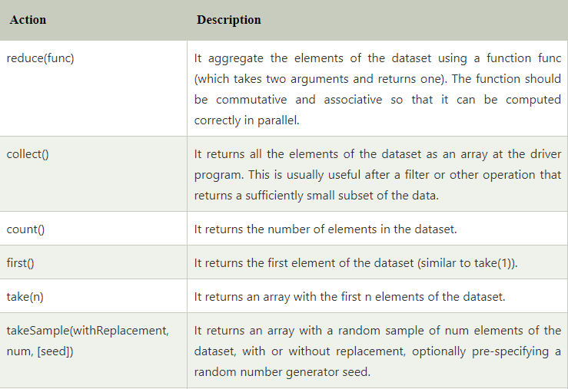

Slide 20
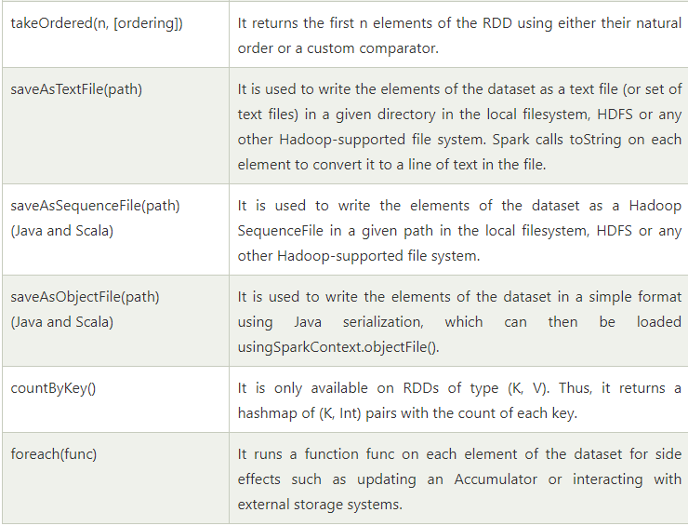

Slide 21
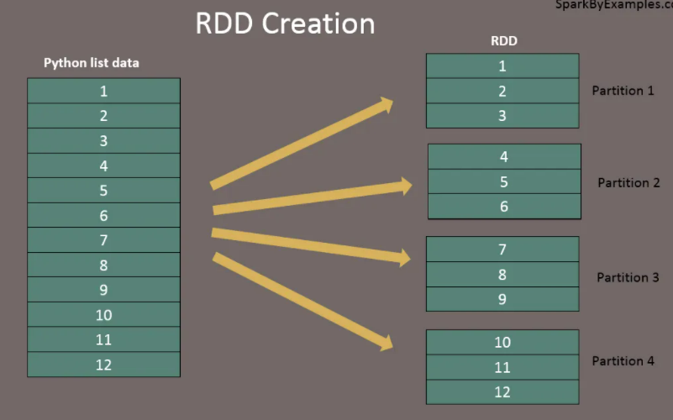

Slide 22
Local mode Vs Cluster mode
The behavior of the above code is undefined, and may not work as intended.
To execute jobs, Spark breaks up the processing of RDD operations into tasks, each of which is executed by an executor.
Prior to execution, Spark computes the task’s closure.
The closure is those variables and methods which must be visible for the executor to perform its computations on the RDD (in this case foreach()). This closure is serialized and sent to each executor.

Slide 23
The variables within the closure sent to each executor are now copies and thus, when counter is referenced within the foreach function, it’s no longer the counter on the driver node.
There is still a counter in the memory of the driver node but this is no longer visible to the executors.
The executors only see the copy from the serialized closure.
Thus, the final value of counter will still be zero since all operations on counter were referencing the value within the serialized closure.

Slide 24
In local mode, in some circumstances, the foreach function will actually execute within the same JVM as the driver and will reference the same original counter, and may actually update it.
To ensure well-defined behavior in these sorts of scenarios one should use an Accumulator.
Accumulators in Spark are used specifically to provide a mechanism for safely updating a variable when execution is split up across worker nodes in a cluster.

Slide 25
In general, closures - constructs like loops or locally defined methods, should not be used to mutate some global state.
Spark does not define or guarantee the behavior of mutations to objects referenced from outside of closures.
Some code that does this may work in local mode, but that’s just by accident and such code will not behave as expected in distributed mode.
Use an Accumulator instead if some global aggregation is needed.

Slide 26
Working with Key/Value Pairs
While most Spark operations work on RDDs containing any type of objects, a few special operations are only available on RDDs of key-value pairs.
The most common ones are distributed “shuffle” operations, such as grouping or aggregating the elements by a key.
In Scala, these operations are automatically available on RDDs containing Tuple2 objects (the built-in tuples in the language, created by simply writing (a, b)).
The key-value pair operations are available in the PairRDDFunctions class, which automatically wraps around an RDD of tuples.

Slide 27

For example, the following code uses the reduceByKey operation on key-value pairs to count how many times each line of text occurs in a file:
when using custom objects as the key in key-value pair operations, you must be sure that a custom equals() method is accompanied with a matching hashCode() method.

Slide 28
END OF SESSION
Q&A

